Slide 1
Object and Class constructors

Slide 2
Visibility Modifiers and Accessor/Mutator Methods (1 of 3)
By default, the class, variable, or method can be accessed by any class in the same package.
public
The class, data, or method is visible to any class in any package.
private
The data or methods can be accessed only by the declaring class.
The get and set methods are used to read and modify private properties.

Slide 3
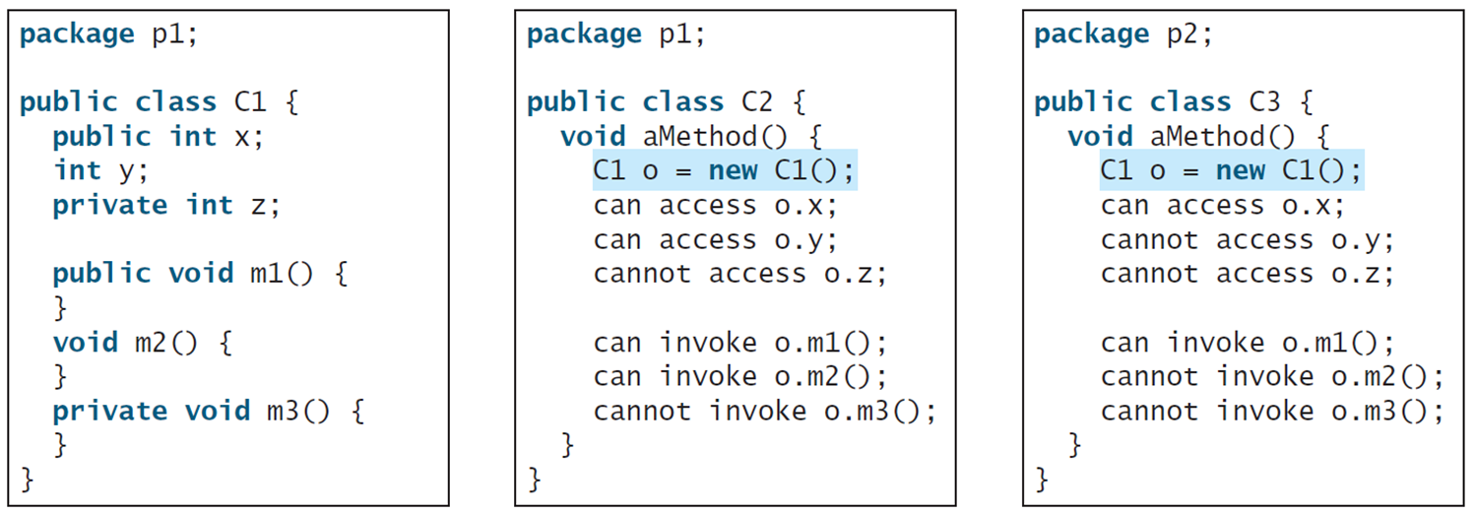
Visibility Modifiers and Accessor/Mutator Methods (2 of 3)
The private modifier restricts access to within a class, the default modifier restricts access to within a package, and the public modifier enables unrestricted access.
Notes:
The computer code consists 14 lines. Line 1, indicates package p1 semicolon. Line 2, blank. Line 3, public class C1 open braces. Line 4, public i n t x semicolon. Line 5, i n t y semicolon. Line 6, private i n t z semicolon. Line 7, blank. Line 8, public void m1 open parenthesis close parenthesis open braces. Line 9, close braces. Line 10, void m2 open parenthesis close parenthesis open braces. Line 11, close braces. Line 12, private void m3 open parenthesis close parenthesis open braces. Line 13, close braces. Line 14, close braces. A middle text box shows the coding for the default modifier restricts access to within a package. The computer code consists 14 lines. Line 1, indicates package p1 semicolon. Line 2, blank. Line 3, public class C2 open braces. Line 4, void a Method open parenthesis close parenthesis open braces. Line 5, C1 o equal to new C1 open parenthesis close parenthesis semicolon. Line 6, can access o period x semicolon. Line 7, can access o period y semicolon. Line 8, cannot access o period z semicolon. Line 9, blank. Line 10, can invoke o period m1 open parenthesis close parenthesis semicolon. Line 11, can invoke o period m2 open parenthesis close parenthesis semicolon. Line 12, cannot invoke o period m3 open parenthesis close parenthesis semicolon. Line 13, close braces. Line 14, close braces. A right side text box shows the coding for the public modifier enables unrestricted access. It consists 14 lines. Line 1, indicates package p2 semicolon. Line 2, blank. Line 3, public class C3 open braces. Line 4, void a Method open parenthesis close parenthesis open braces. Line 5, C1 o equal to new C1 open parenthesis close parenthesis semicolon. Line 6, can access 0 period x semicolon. Line 7, cannot access 0 period y semicolon. Line 8, cannot access 0 period z semicolon. Line 9, blank. Line 10, can invoke o period m1 open parenthesis close parenthesis semicolon. Line 11, cannot invoke 0 period m2 open parenthesis close parenthesis semicolon. Line 12, cannot invoke 0 period m3 open parenthesis close parenthesis semicolon. Line 13, close braces. Line 14, close braces.

Slide 4
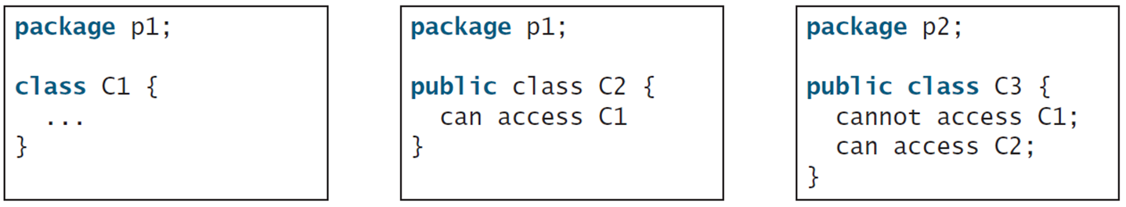
Visibility Modifiers and Accessor/Mutator Methods (3 of 3)
The default modifier on a class restricts access to within a package, and the public modifier enables unrestricted access.
Notes:
The box contains 5 lines. Line 1, indicates package p1 semicolon. Line 2, blank. Line 3, class C1 open braces. Line 4, dot dot dot. Line 5, close braces. A middle text box also shows the default modifier on a class restricts access to within a package. The box contains 5 lines. Line 1, indicates package p1 semicolon. Line 2, blank. Line 3, public class C2 open braces. Line 4, can access C1. Line 5, close braces. A left side text box shows the public modifier enables unrestricted access. The box contains 6 lines. Line 1, package p2 semicolon. Line 2, blank. Line 3, public class C3 open braces. Line 4, cannot access C1 semicolon. Line 5, can access C2 semicolon. Line 6, close braces.

Slide 5
Why Data Fields Should Be Private?
To protect data.
To make code easy to maintain.

Slide 6
Private fields
A field that cannot be accessed from outside the class
private type name;
Examples:
private int id;
private String name;

Slide 7
Accessing private state
// A "read-only" access to the x field ("accessor")
public int getX() {
return x;
}
// Allows clients to change the x field ("mutator")
public void setX(int newX) {
x = newX;
}
Client code will look more like this:
System.out.println(p1.getX());
p1.setX(14);

Slide 8
Getters and Setters
It is a good practice to set class fields private to prevent unintentional changes by outsize program. To accommodate leagal modifications by the outsize program, programmer should create mutators and accessors for the fields.
A mutator method (also called setter) may modify ("mutate") a class' fields.
An accessor method (also called getter) accesses fields but may not modify a class' fields.

Slide 9
What Class is Immutable?
For a class to be immutable, it must mark all data fields private and provide no mutator methods and no accessor methods that would return a reference to a mutable data field object.

Slide 10
The This Keyword
The this keyword is the name of a reference that refers to an object itself. One common use of the this keyword is reference a class’s hidden data fields.
Another common use of the this keyword to enable a constructor to invoke another constructor of the same class.

Slide 11
The this keyword
this : Refers to the implicit parameter inside your class.
(a variable that stores the object on which a method is called)
Refer to a field: this.field
Call a method: this.method(parameters);
One constructor this(parameters); can call another:

Slide 12
Reference the Hidden Data Fields
Notes:
It consists 12 lines. Line 1, indicates public class F open braces. Line 2, private i n t i equal to 5 semicolon. Line 3, private static double k equal to zero semicolon. Line 4, blank. Line 5, void s e t I open parenthesis i n t i close parenthesis open braces. Line 6, t h i s period i equal to i semicolon. Line 7, close braces. Line 8, blank. Line 9, static void s e t K open parenthesis double k close parenthesis open braces. Line 10, F period k equal to k semicolon. Line 11, close braces. Line 12, close braces. A right hand side text box shows the coding of F1 and F2 are the objects of F. It consists 7 lines. Line 1, F f1 equal to new F open parenthesis close parenthesis semicolon F f2 equal to new F open parenthesis close parenthesis semicolon. Line 2, blank. Line 3, Invoking f1 period s e t I open parenthesis ten close parenthesis is to execute. Line 4, t h i s i equal to 10 comma where t h i s refers f1. Line 5, blank. Line 6, Invoking f2 period s e t I open parenthesis 45 close parenthesis is to execute. Line 7, t h i s i equal to 45 comma where t h i s refers f2.

